Slide 1
The Exceptional School Cybrary/Creative Commons
Betsy Eubanks interviews for The School for Creative Studies
Thursday, March 21, 2013
Please click at your own speed. Slides are not timed, in order that you may navigate to embedded links, if desired.

Slide 2
How do I envision the ideal cybrary/creative commons for students?
Among the elements to consider are:
Architecture (if new construction is allowed)
Facility Arrangement
Print Resources
Electronic Resources
Computers
AV Equipment

Slide 3
The illustration below is an interesting concept adapted by a public library
←
iPads mounted at different nonfiction areas that are loaded with Apps related to that subject area.

Slide 4
Sometimes I visualize a completely virtual library/cybrary, but do not see its advantages, except in a limited sense, for today’s schools

Slide 5
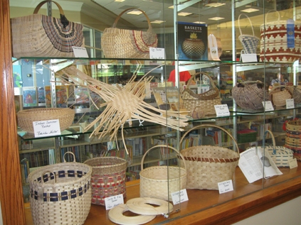
Because I am fascinated with the idea of students becoming more ‘globally literate,’ I would love to have ever-changing exhibit/resource areas to highlight various continents/countries. All exhibits would include artifacts, print and electronic resources, including music, art, and cultural features. (I currently use the UNC International Outreach Office to obtain these types of artifacts on a limited time basis-students love them!)

Slide 6
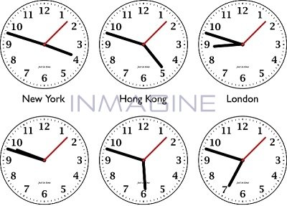
Clocks around the walls would give the time in different countries around the world (with connections to a news source in that country)
→→ London News

Slide 7
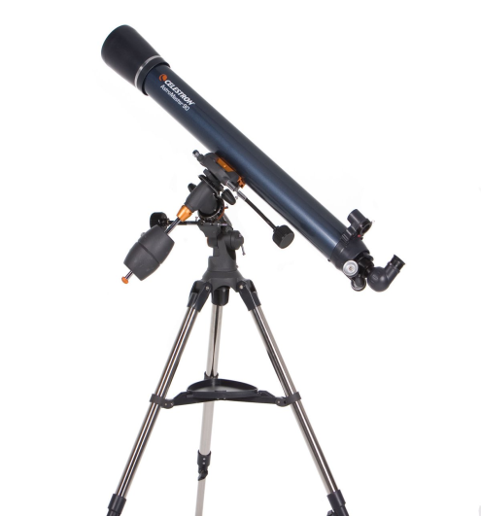
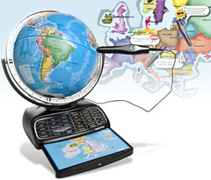
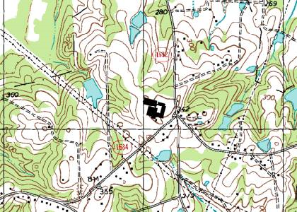
THINGS to use and learn from
Interactive
Globes,
Telescopes,
Maps
↓School for Creative Studies

Slide 8
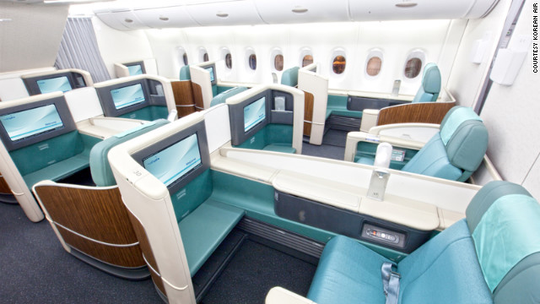
Creative Cubicles
Individual or group spaces with inspirational, creative apps loaded according to subject area.
(the picture is an airplane concept – use your imagination to translate it to the school environment!)

Slide 9
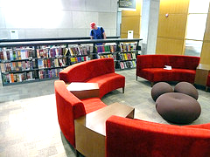
A leisure reading/listening area
Complete with
headsets at
every seat and
a touch screen
to select music
you want to
hear.
(sort of like) Playlist.com

Slide 10
With today’s budget, some of those ‘ideal’ facilities may be out of reach, but it doesn’t hurt to imagine…
More reasonable and accessible are resources for students:
PRINT resources:
Encyclopedias
Maps
Magazines
Excellent reference sources on major topics such as the Holocaust, Civil Rights
Selected fiction – the ‘best of the best’ in classic and contemporary fiction

Slide 11
Reasonable Electronic Resources
Ebooks (‘best of the best’ literature)
eReaders: Kindle/Nook/Tablet
Online, subscription databases (Facts on File; Culturegrams; SIRS; EBSCO)
Laptops
iPads (checkout availability)
Digital cameras & camcorders
Document cameras
Data projectors
Video editing equipment
Smart boards
Student Response System

Slide 12
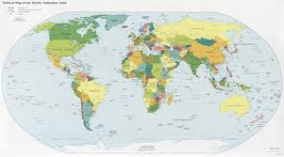
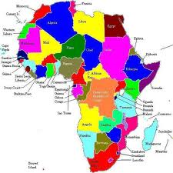
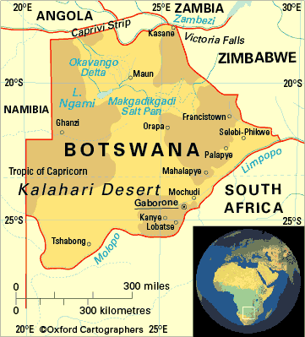
MY PEDAGOGICAL PHILOSOPHY What kind of library instruction is most effective and most important for students to know as they move toward higher education?
Narrowing Topics
↓
→

Slide 13
Using Technology as a Tool
Animoto
Prezi
Glogster
Noodle Tools
Online Live Binders
Symbaloo
Weebly
And many others that are created daily!

Slide 14
Understanding Intellectual Property
Giving credit → → Bibliographic Citation
Copyright
Plagiarism
Types of information or material which cannot be copied without giving credit.
Effective instructional technique:
Give actual, accurate examples
Queen & David Bowie
Vanilla Ice

Slide 15
Evaluating Information Print & Nonprint
Effective instructional techniques
Utilize technology for instruction (utube tutorials; online PPTs; Webpath Express; Noodle Tools)

Slide 16
Media Literacy
How to access information from different sources – print/electronic/people
Know which sources are best for your purpose
Understand the different types of media and how they affect your life.

Slide 17
Global Awareness
Understand what’s going on in the world.
Respect other cultures
Take responsibility for your part

Slide 18
Metacognition
“Awareness or analysis of one's own learning or thinking processes Merriam-Webster Online Dictionary
Always ask “why?”
Think for yourself

Slide 19
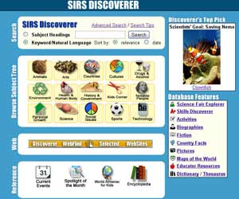
What technology tools support the teaching of research skills and information literacy?
Online Databases & Encyclopedias

Slide 20
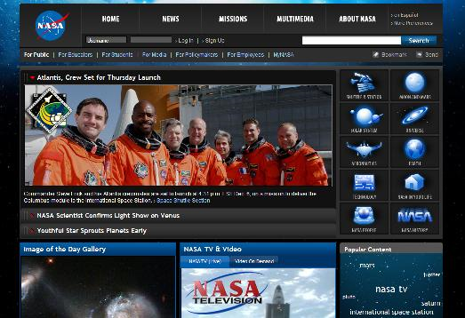
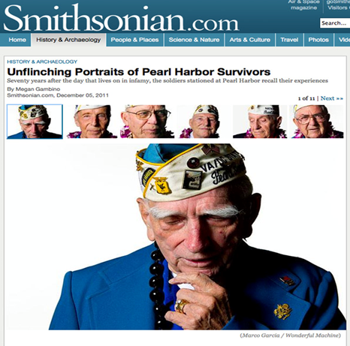
Accurate, authoritative websites

Slide 21
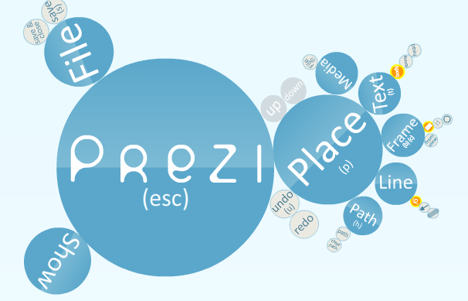
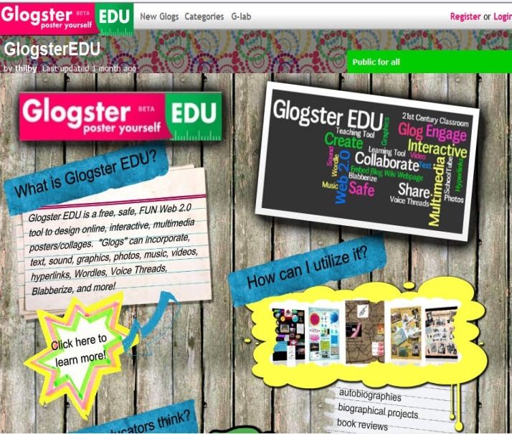
Presentation Tools
WordPress.com

Slide 22
As a matter of fact…..
Technology itself can help you find
technology tools…

Slide 23
Last, but definitely not least, my teaching philosophy must embrace…
The wide,
Wonderful
world of
READING!!

Slide 24
OMG!!

Slide 25
And so much more
Manga
Anime
Poetry
Short Stories
Shakespeare
Hooray for YA

Slide 26
My pedagogical practices are ever-changing in order to take into account current library trends and practices that engage students and teachers
New spatial designs of libraries: “Starbucks Library”
More emphasis on ‘digital citizenship’: Netiquette
Collaboration with others: wikis, blogs, nings
Going mobile – making connections Texting/Photos/Twitter/QR Codes
-
Interactive technologies : Smart Boards
Collaborative teaching with the librarian
Curation – Digital Collections – Live Binders
An example A new version of the old “Pathfinder”

Slide 27
I believe that I can best support all patrons in our exceptional school cybrary/creative commons in these ways:
BE AVAILABLE
LISTEN
LEARN
ADVOCATE
Believe that every child can succeed and my actions must facilitate that success!

Slide 28
Thank you for your kind attention!
Betsy Eubanks
bookwoman1027@aol.com
@bookwoman1027
WordPress: Creative Comments Blog
Animoto Samples: Media Center Orientation
BattleoftheBooks-Githens
Utube Samples to incorporate in teaching:
Back to School in Haiti
Reading Rap Video
Betsy’s Sample Idea for Motivating Creativity: Education Week Gallery

